Slide 1
Optimize Deep Models via Detecting the Edge of Criticality
Course Project Proposal
Zhiqian Chen

Slide 2
Outline
Motivation
Solution
Preliminary Results

Slide 3
Motivation
In current AI tasks
Face Recognition/Image captioning/Visual QA
human learn more from less
machine learn less from more
machine is data-driven = 4-year-old child[1]
This implies the learning methods between are different
Borrow ideas from Biology/Physics

Slide 4
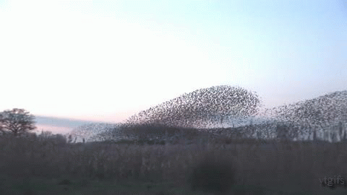
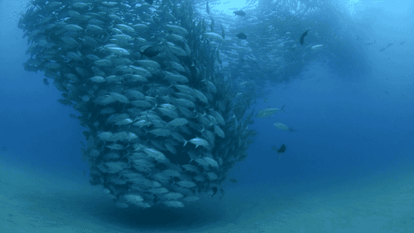
Motivation
Why don’t they crash?
Model the distributed behavior [2]
(1) Collision Avoidance,
(2) Velocity Matching,
(3) Flock Centering.

Slide 5
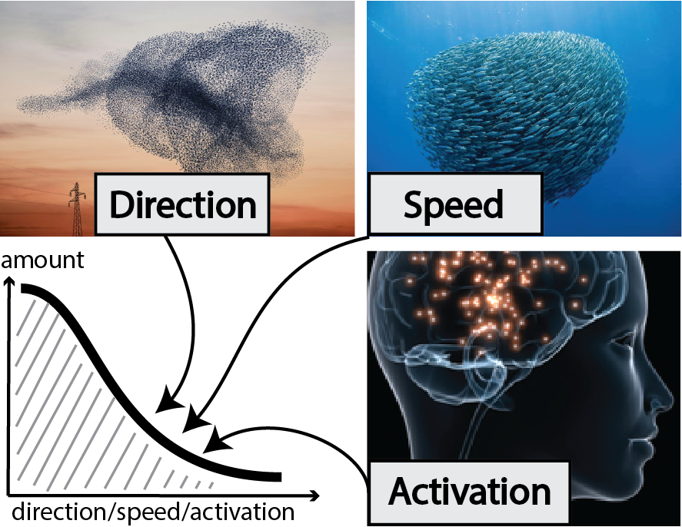
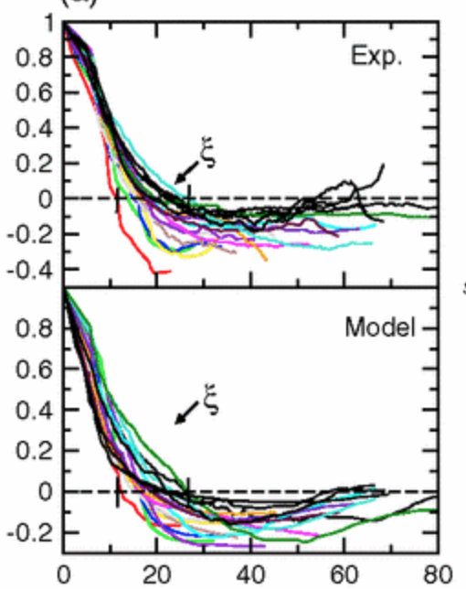
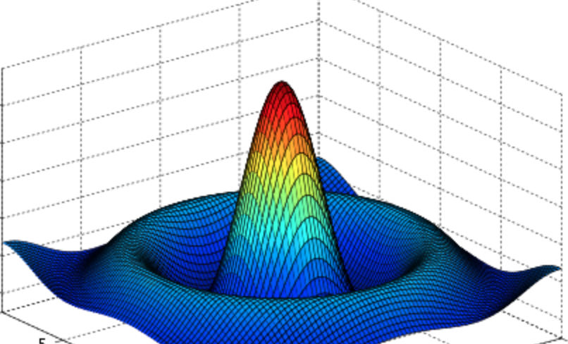
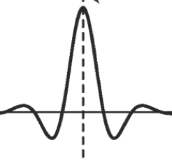
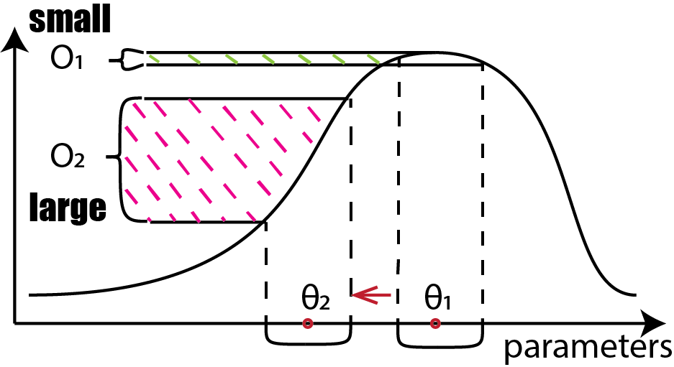
Motivation
Edge of Criticality theory
collective intelligence
micro - macro
order <— edge —> disorder
Power law distribution
global relationship
Maximize 2nd order info

Slide 6
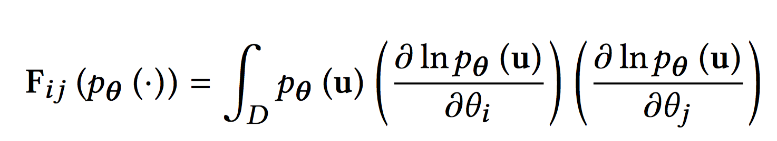
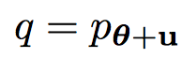
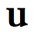
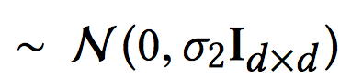
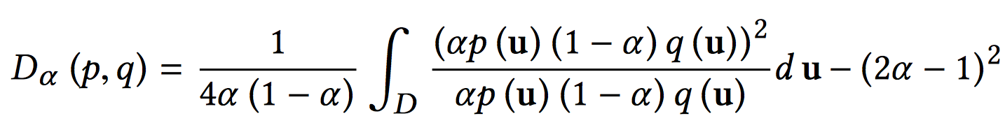
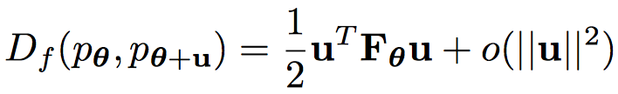
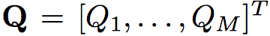
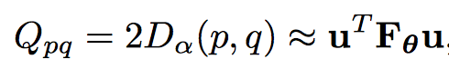
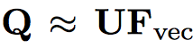

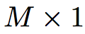
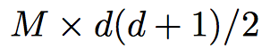
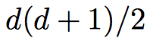
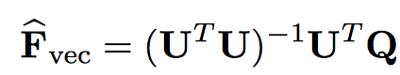
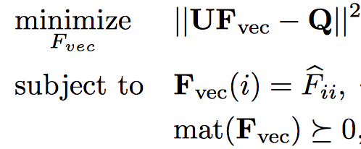
Solution
Fisher information matrix is symmetric positive semidefinite:
perturbed
f-divergence
Friedman-Rafsky
Least Square
F is not SD; linear complexity
SDP
Accurate; Quadratic complexity

Slide 7
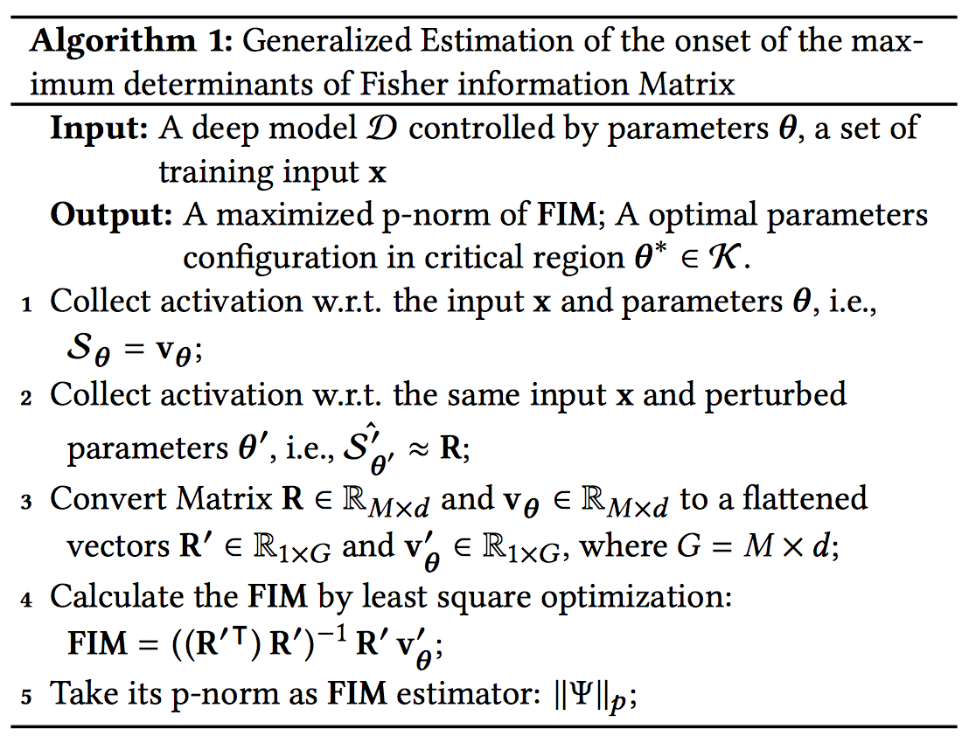
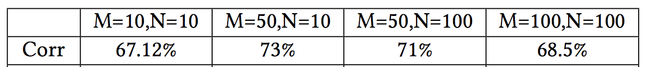
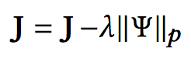
Solution
FIM determinant[3]
p norm of the result form least square
Empirical correlation test:
M-matrix size, N-Sequence length

Slide 8
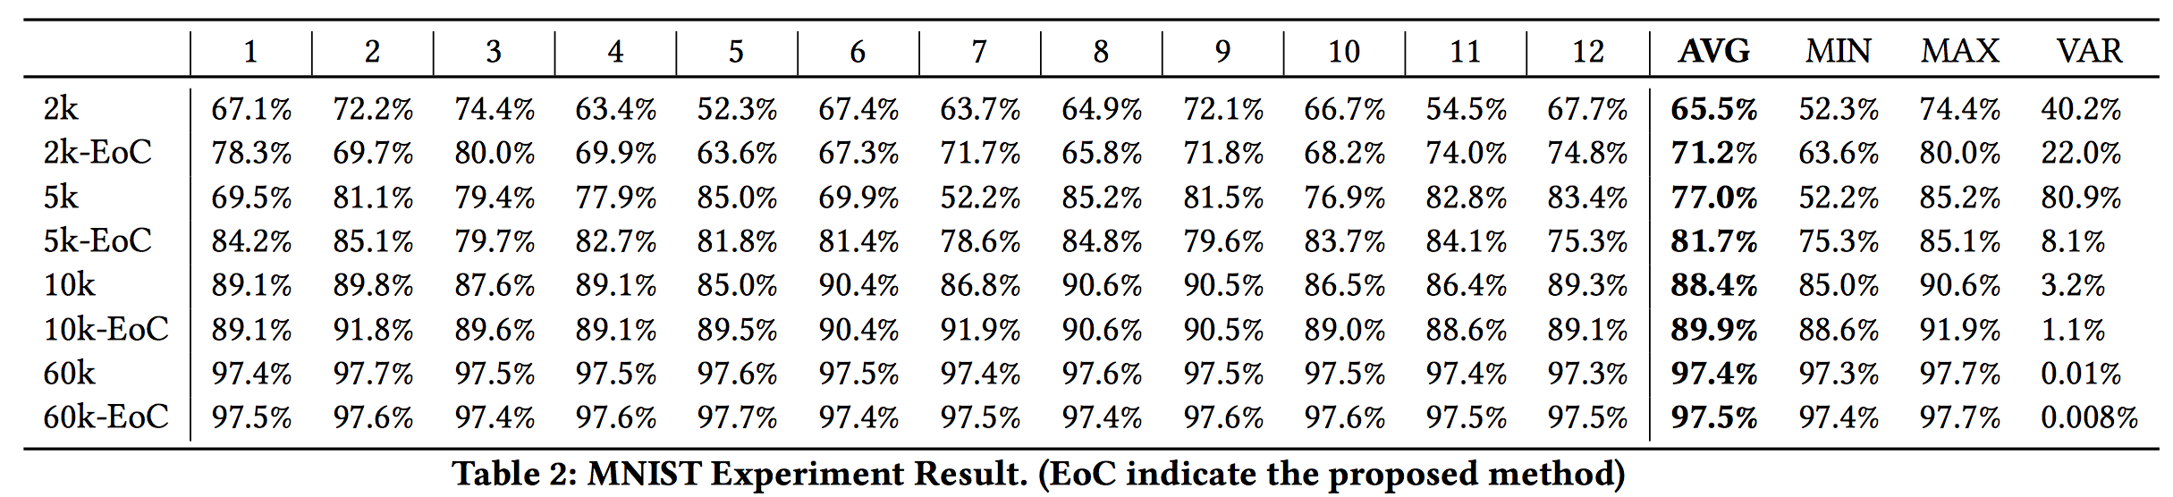
Preliminary results
Additional Optimization: layer-wise dropout[4]
A standard benchmark: MNIST
When data is small, stability and precision is improved
When data is large, no significant improvement

Slide 9
Reference
[1] Ohlsson, Stellan, et al. "Measuring an artificial intelligence system’s performance on a verbal iq test for young children." Journal of Experimental & Theoretical Artificial Intelligence (2016): 1-15.
[2] Reynolds, Craig W. "Flocks, herds and schools: A distributed behavioral model." ACM SIGGRAPH computer graphics 21.4 (1987): 25-34.
[3] Livi, Lorenzo, Filippo Maria Bianchi, and Cesare Alippi. "Determination of the edge of criticality in echo state networks through Fisher information maximization." IEEE Transactions on Neural Networks and Learning Systems (2017).
[4] Srivastava, Nitish, et al. "Dropout: a simple way to prevent neural networks from overfitting." Journal of Machine Learning Research 15.1 (2014): 1929-1958.

